Slide 1
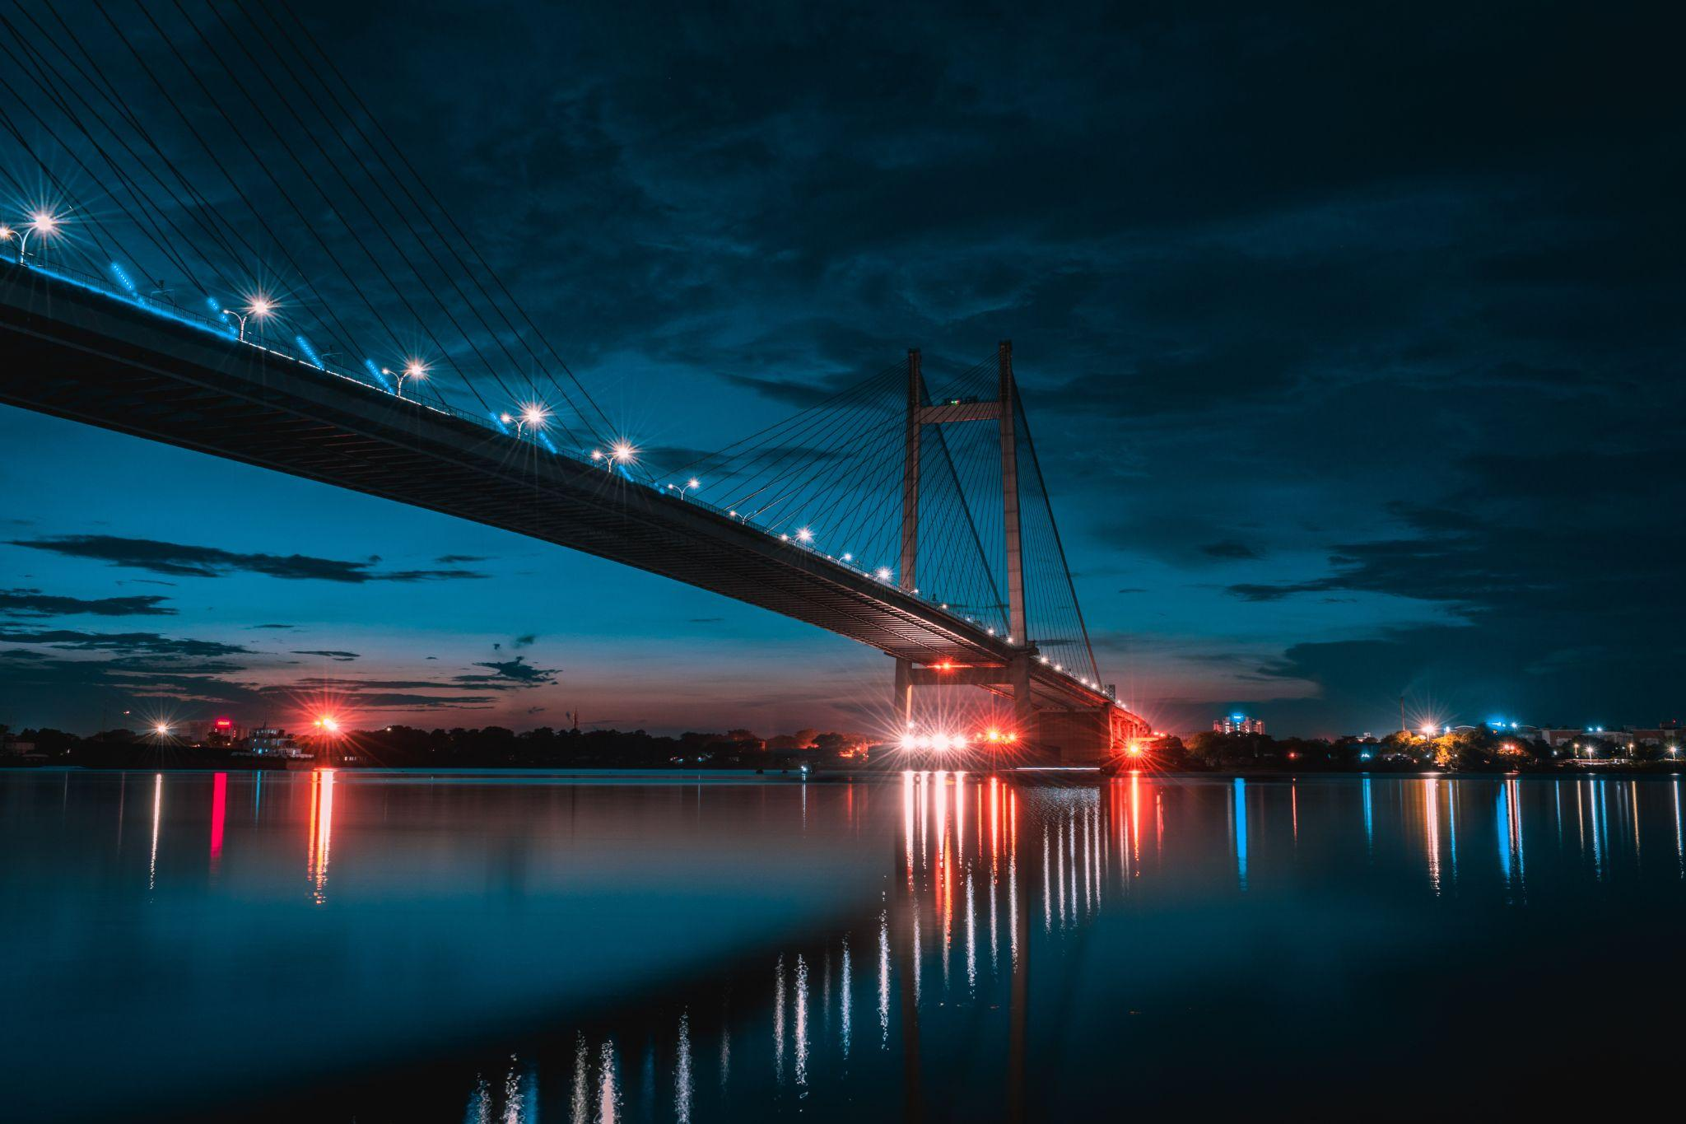
KOLKATA
THE CITY OF JOY

Slide 2
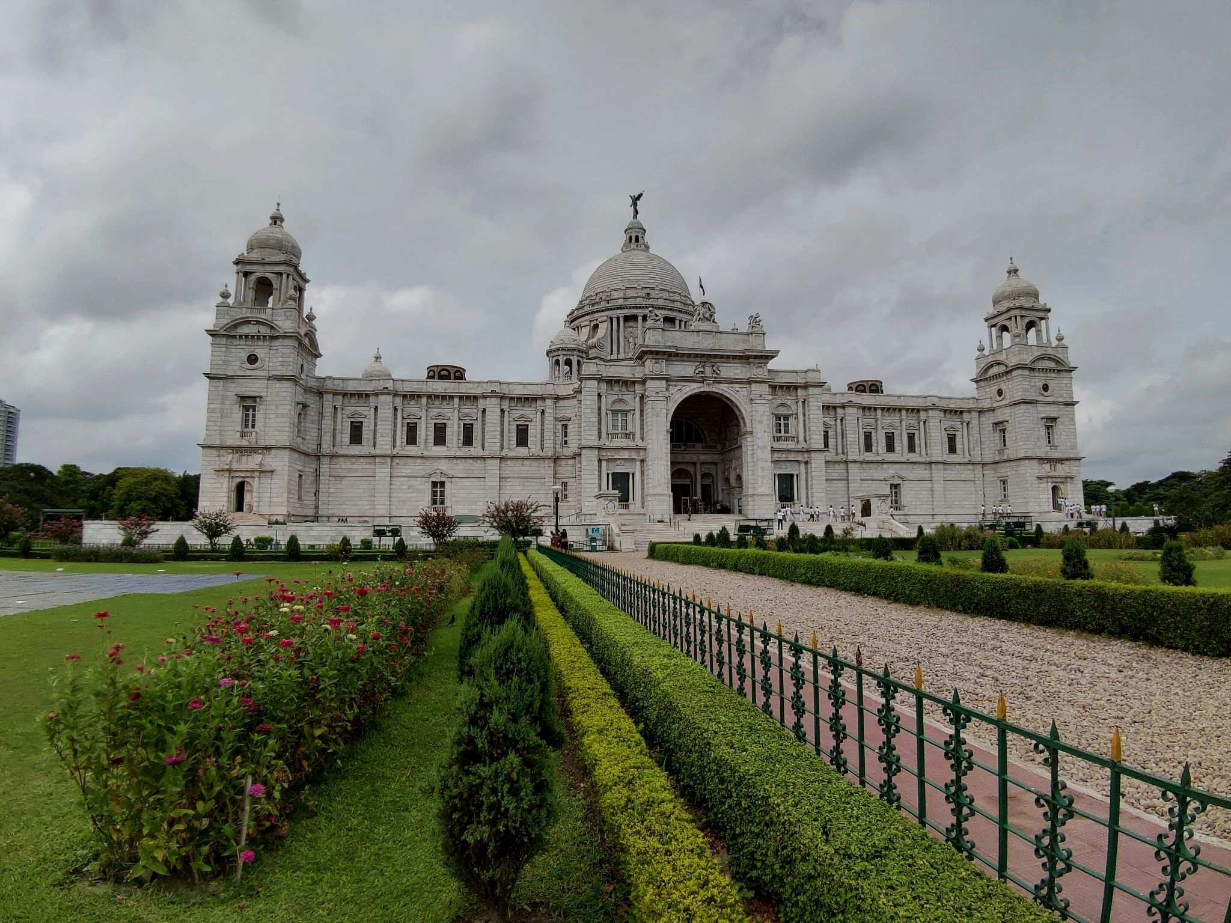
KOLKATA, FORMERLY KNOWN AS CALCUTTA, IS SITUATED IN THE EASTERN PART OF INDIA, ALONG THE BANKS OF THE HOOGHLY RIVER. IT IS THE CAPITAL OF THE INDIAN STATE OF WEST BENGAL AND IS A MAJOR CULTURAL AND COMMERCIAL CENTER IN THE REGION.

Slide 3
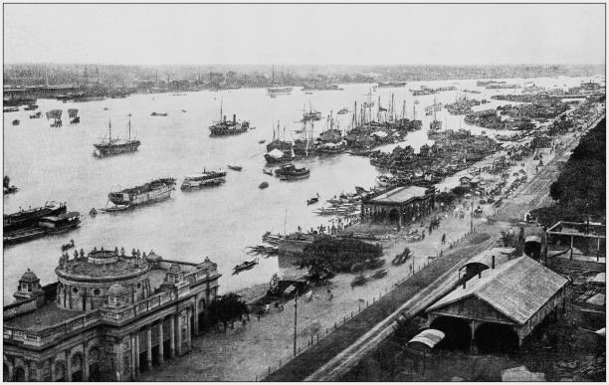
HISTORICAL CONTEXT
FOUNDATION AND COLONIAL ERA
KOLKATA WAS FOUNDED BY JOB CHARNOCK, AN ENGLISH MERCHANT, IN THE LATE 17TH CENTURY. INITIALLY A SMALL FISHING VILLAGE, IT GREW INTO A THRIVING TRADE POST UNDER THE BRITISH EAST INDIA COMPANY.

Slide 4
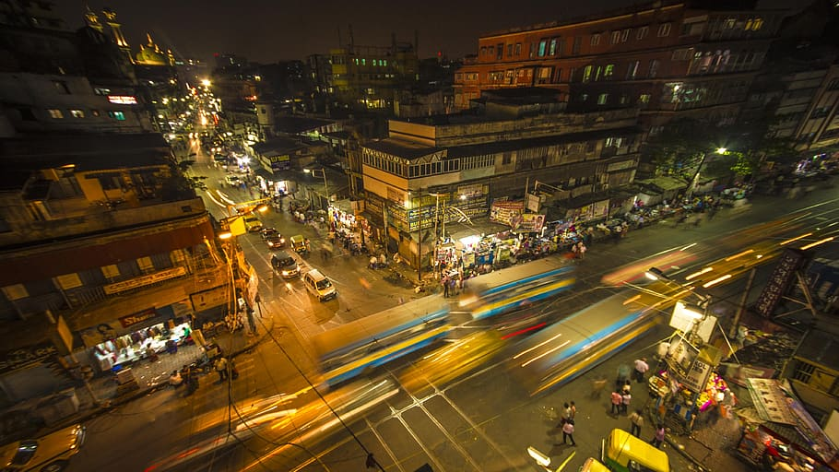
CULTURAL RENAISSANCE
THE 19TH AND EARLY 20TH CENTURIES WERE A TIME OF CULTURAL RESURGENCE IN KOLKATA, KNOWN AS THE BENGAL RENAISSANCE. IT SAW THE EMERGENCE OF LUMINARIES LIKE RABINDRANATH TAGORE, SWAMI VIVEKANANDA, AND ISHWAR CHANDRA VIDYASAGAR, WHO CONTRIBUTED SIGNIFICANTLY TO LITERATURE, ART, AND SOCIAL REFORM.

Slide 5
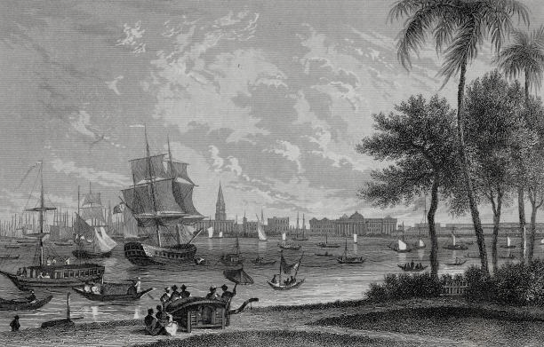
KEY HISTORICAL EVENTS
Partition of Bengal (1905)
The controversial decision to partition Bengal by Lord Curzon was met with strong opposition and eventually led to the reunification of Bengal in 1911.
Indian Independence Movement
Kolkata played a pivotal role in India's struggle for independence. It was the birthplace of several revolutionary movements, and leaders like Subhas Chandra Bose and Netaji played a significant role in galvanizing the fight against British rule.
Transfer of Capital (1911)
In 1911, the capital of British India was moved from Kolkata to New Delhi, marking a significant shift in the political landscape of the subcontinent.
Post-Independence Era
After India gained independence in 1947, Kolkata continued to be a hub of political and cultural activities. It experienced periods of rapid industrialization and later faced economic challenges.

Slide 6
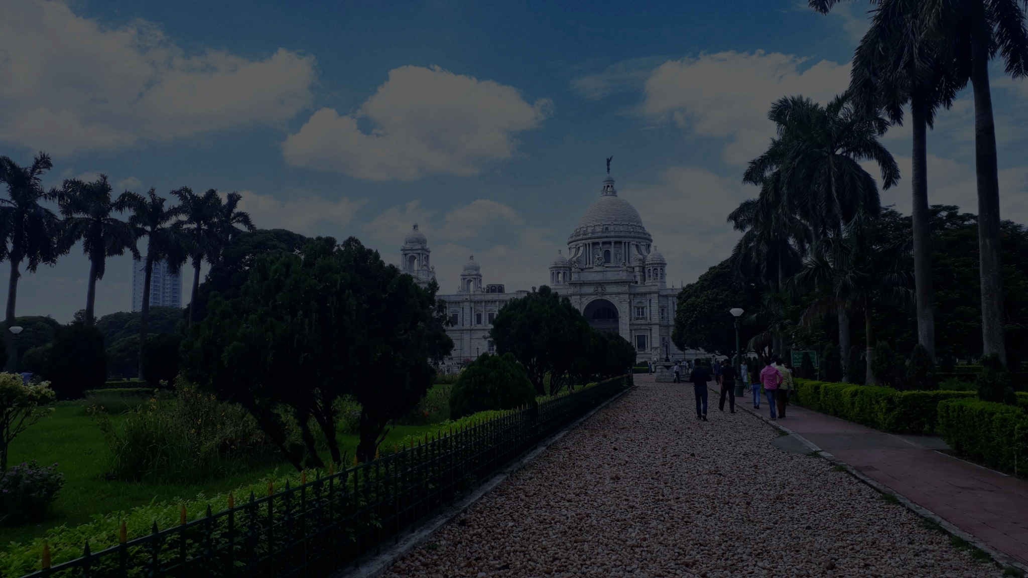
Climate
Kolkata experiences a tropical wet-and-dry climate. Summers are hot and humid, with temperatures often exceeding 30°C (86°F). Monsoons bring heavy rainfall from June to September, while winters are mild and pleasant.

Slide 7
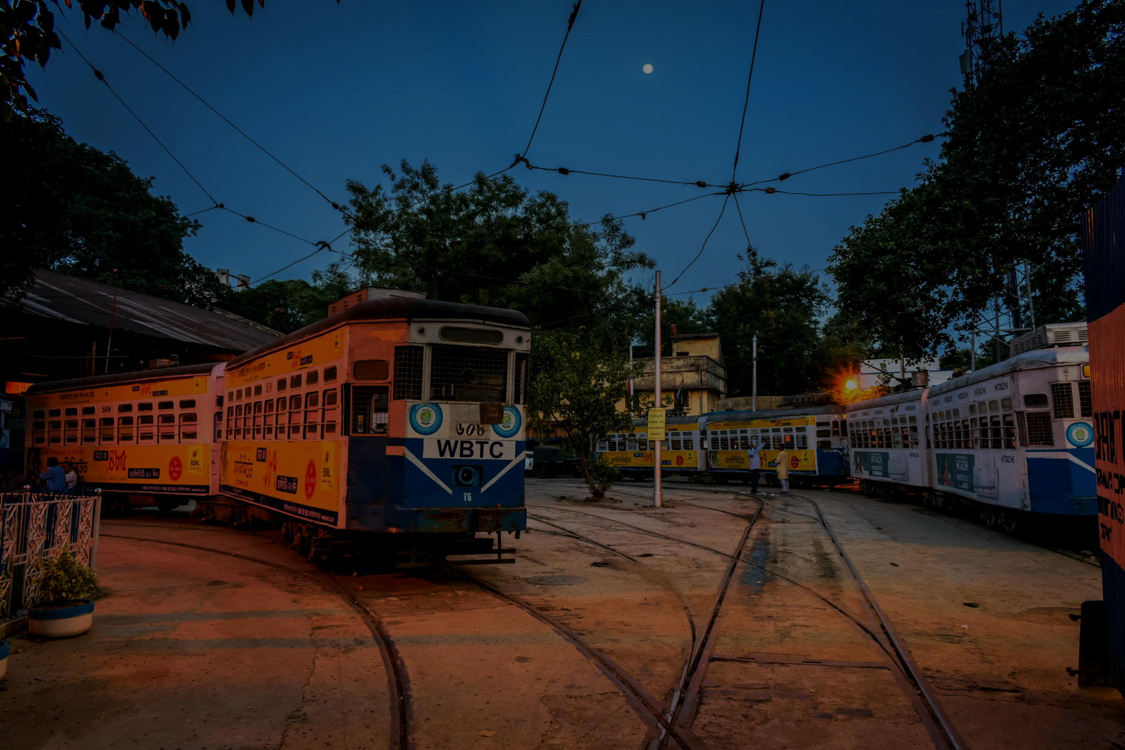
City Planning
Kolkata is known for its grid-like urban layout, especially in the older parts of the city. The central business district is characterized by colonial-era architecture and wide avenues.

Slide 8
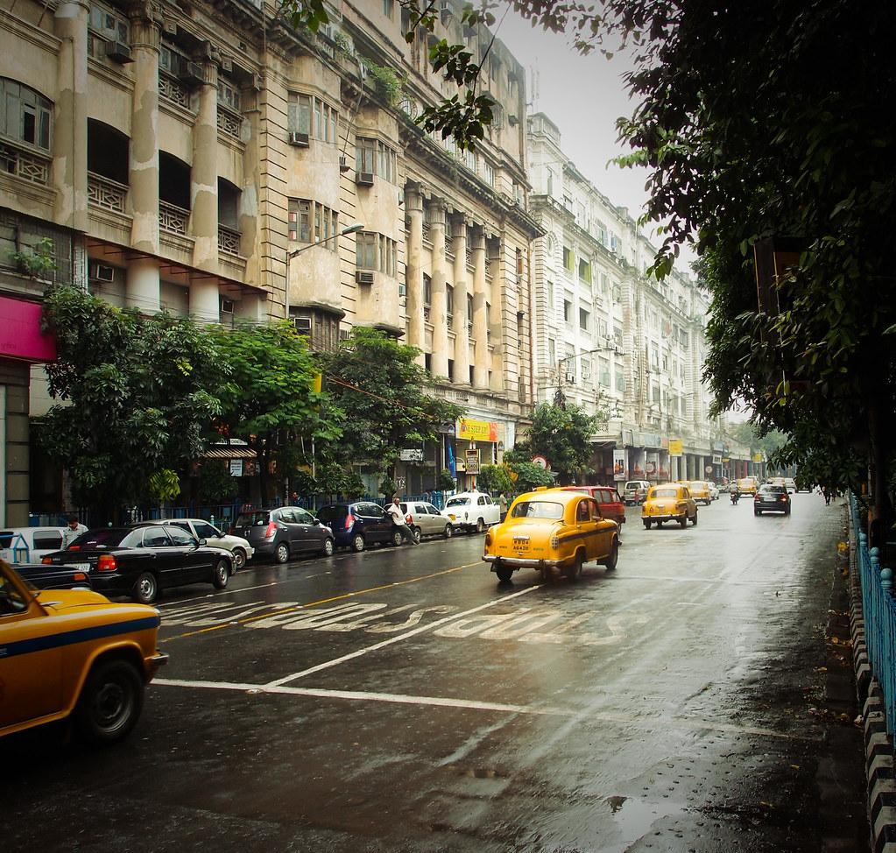
Notable Districts
The city is divided into various districts, each with its unique character. Some notable districts include:
North Kolkata: Known for its historical neighborhoods, cultural institutions, and traditional markets.
South Kolkata: Home to upscale residential areas, educational institutions, and modern commercial centers.

Slide 9
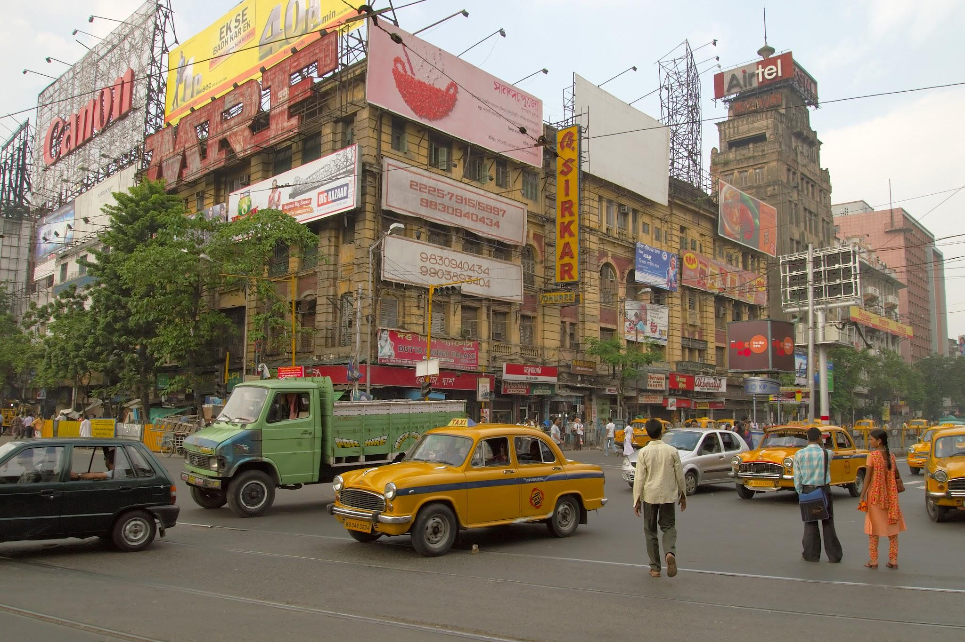
Green Spaces and Water Bodies
Despite its urban density, Kolkata has several green spaces like the Maidan and Rabindra Sarobar, providing recreational opportunities. The Hooghly River and its numerous tributaries add to the city's natural charm.

Slide 10
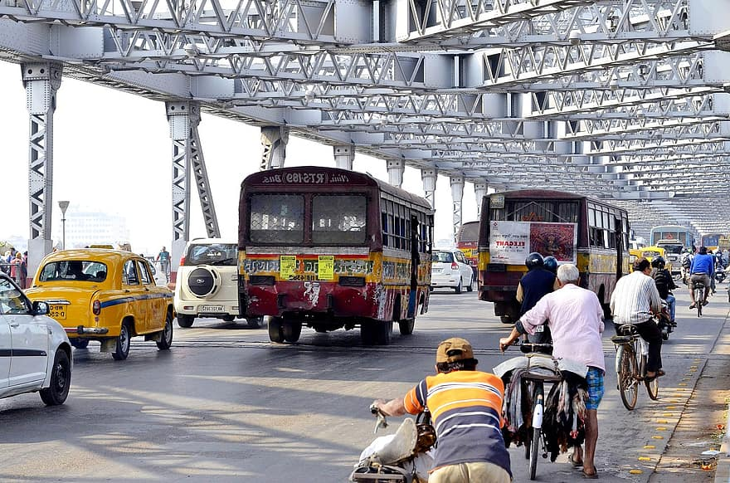
Topography
The city's terrain is characterized by a flat landscape, with the elevation gradually increasing towards the western parts. The presence of the Hooghly River has played a crucial role in the city's development and connectivity.

Slide 11
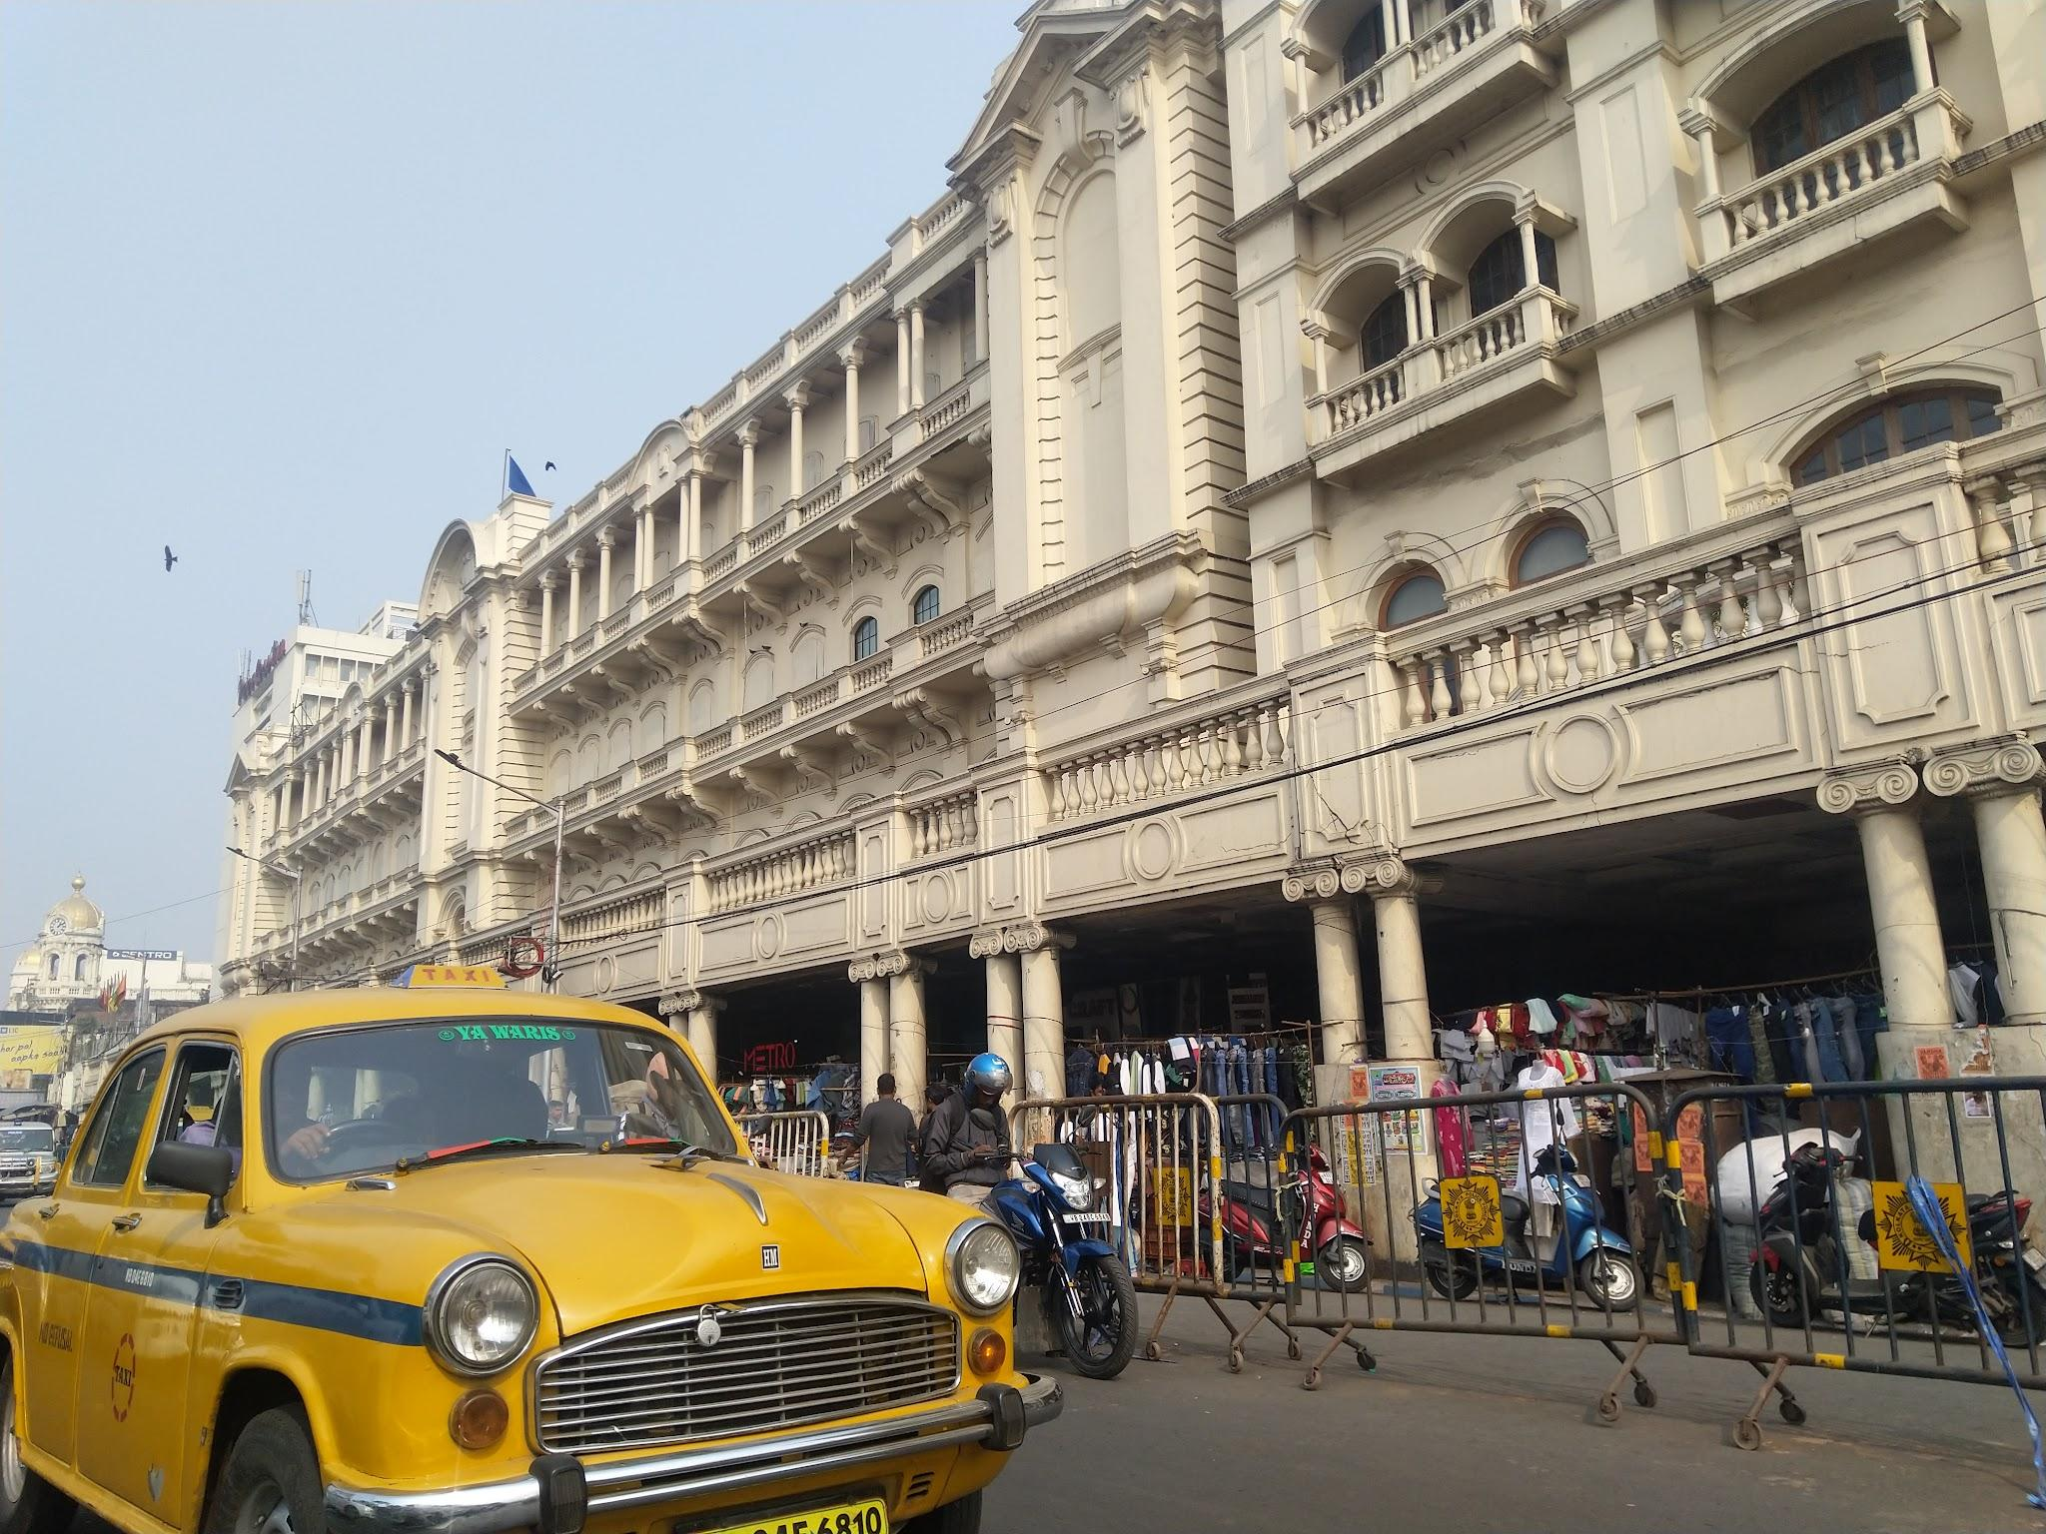
Location
Kolkata is situated on the eastern bank of the Hooghly River, a distributary of the Ganges River. It is located in the eastern part of India, in the state of West Bengal.

Slide 12
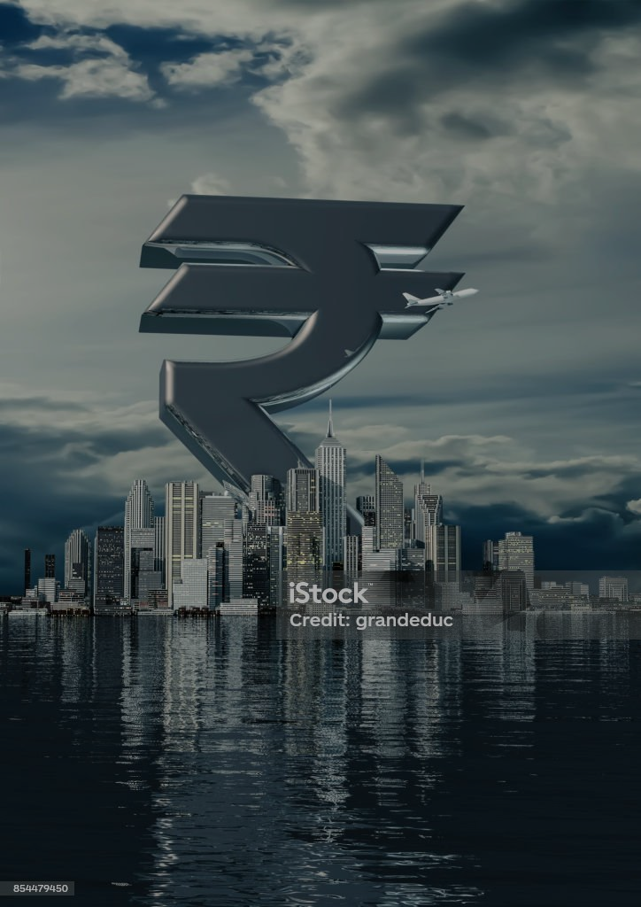
ECONOMY
Kolkata is the prime business, commercial and financial hub of eastern India and the main port of communication for the North East Indian states. Kolkata is the third richest city in India after Mumbai and Delhi, with a GDP (PPP) of $150.1 billion (as of 2017).Kolkata is home to India's oldest, stock exchange company (bourse) – The Calcutta Stock Exchange.Kolkata is home to many industrial units operated by large public- and private-sector corporations; major sectors include Steel, Heavy engineering, Mining, Minerals, cement, pharmaceuticals, Food processing, Agriculture, electronics, textiles, and jute.

Slide 13

MAJOR COMPANIES
Kolkata is home to many industrial units operated by large public- and private-sector corporations; major sectors include steel, heavy engineering, mining, minerals, cement, pharmaceuticals, food processing, agriculture, electronics, textiles, and jute.
Companies such as ITC Limited, ABP Group, CESC Limited, Exide Industries, Emami, Eveready Industries India, Lux Industries, Rupa Company, Berger Paints, Patton International Limited, Birla Corporation, Khaitan India Ltd.

Slide 14
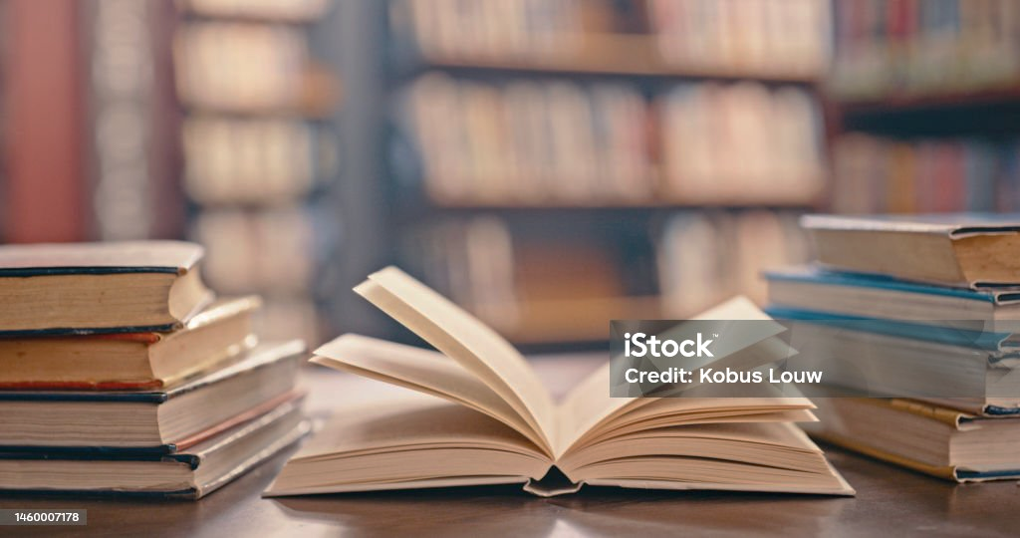
EDUCATION
Home to more than twenty universities, excellent schools and outstanding colleges, Kolkata is the educational centre of eastern India. It is a popular destination for students of various subjects as this city has seen the rise of many notable scholars and Nobel prize winners. There is no dearth of educational opportunities in this city and therefore choosing a course and college can be a daunting task for an aspiring student.

Slide 15
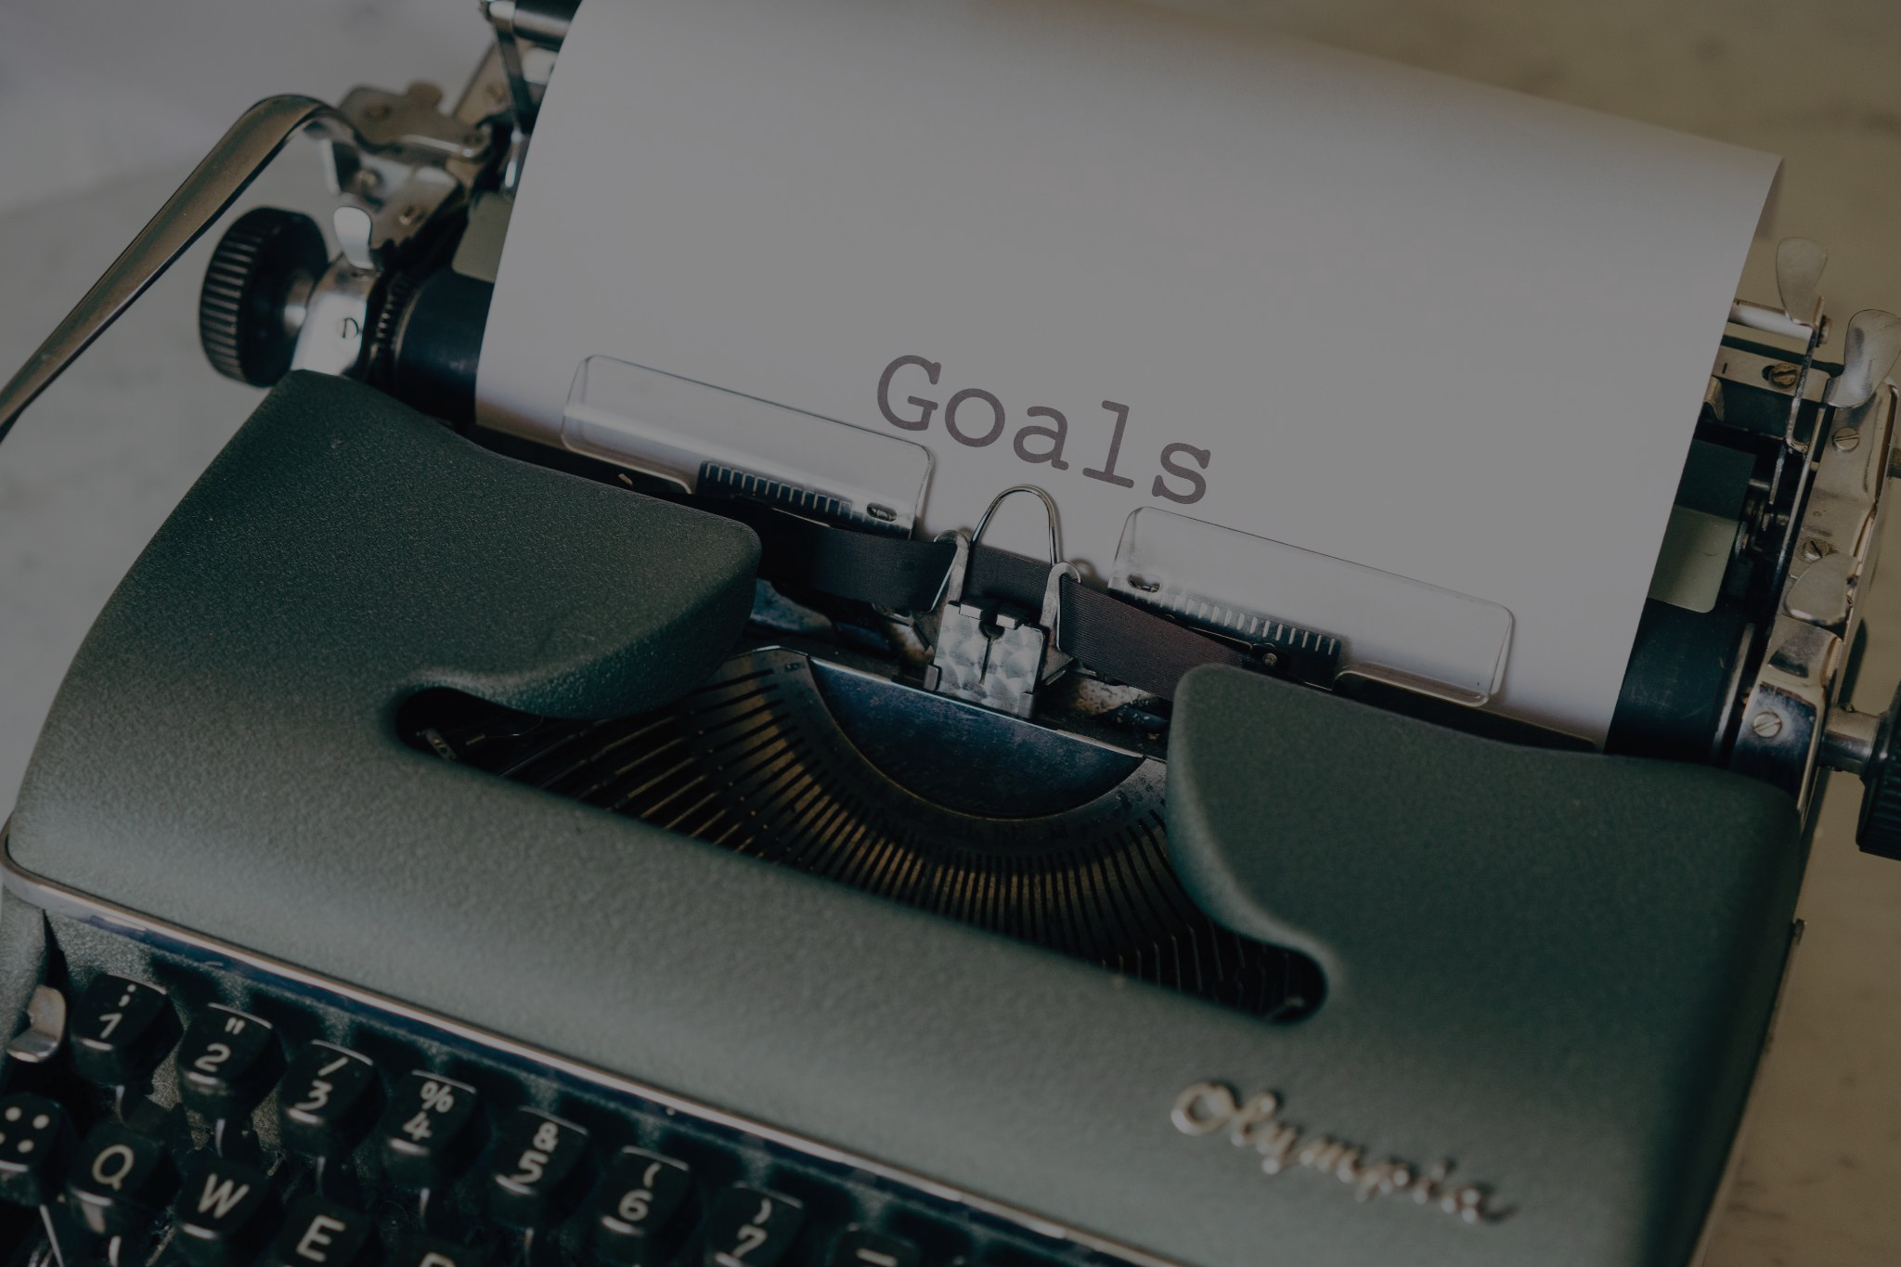
Here are some of the achievements of Kolkata in the education sector
As of March 31, 2014, 40,113 classrooms have been constructed
Rs 50,000 as library grant has been given to each of 1,107 schools upgraded from Madhyamik to Higher Secondary
Rs 2 lakh as laboratory grant has been given to each of 3,717 schools upgraded from Madhyamik to Higher Secondary
3. To make students more IT-savvy, computers and related equipment have been provided to 2600 Madhyamik and Higher Secondary schools, under the Government’s ICT scheme
74,650 primary school teachers have been enabled help in completing the Diploma in Elementary Education (D El Ed) course
27,894 teachers have been enabled help in completing Bachelor in Education (B Ed) course through distance learning mode

Slide 16
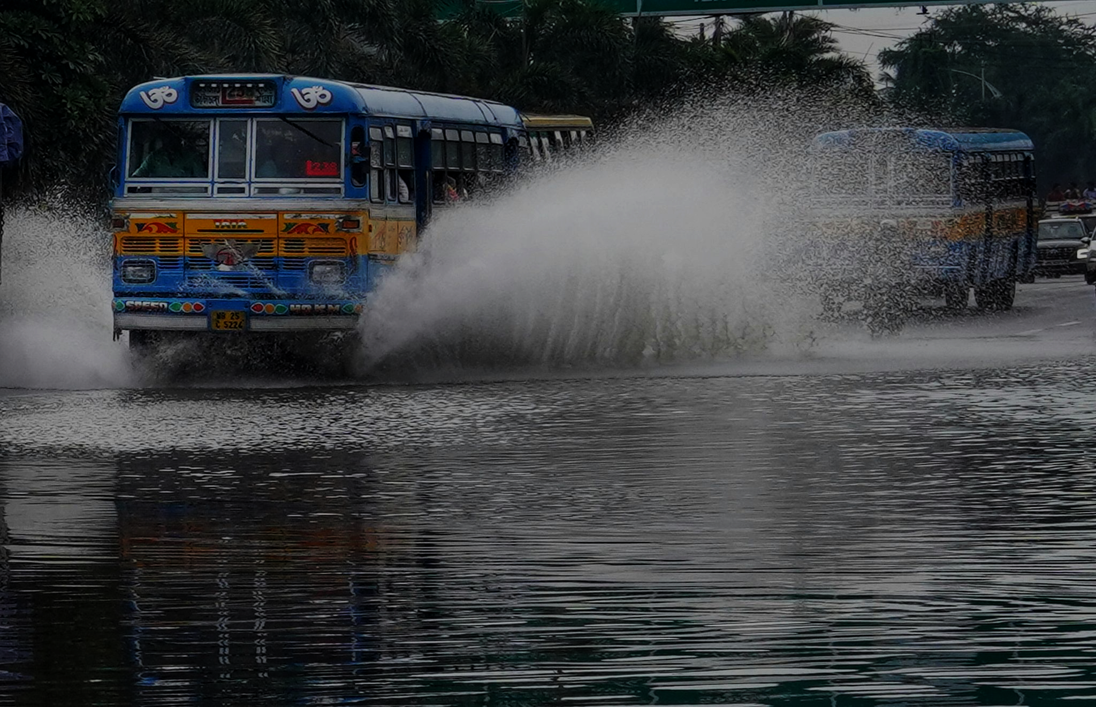
The transport system of Kolkata, a city in India, is a mix of modern mass rapid transport and old transport modalities like rickshaws. Kolkata is connected to the rest of India by the National Highways, the extensive network of the Indian Railways, National Waterways and by air. The most traffic to Northeast India route via Kolkata.
TRANSPORTATION

Slide 17
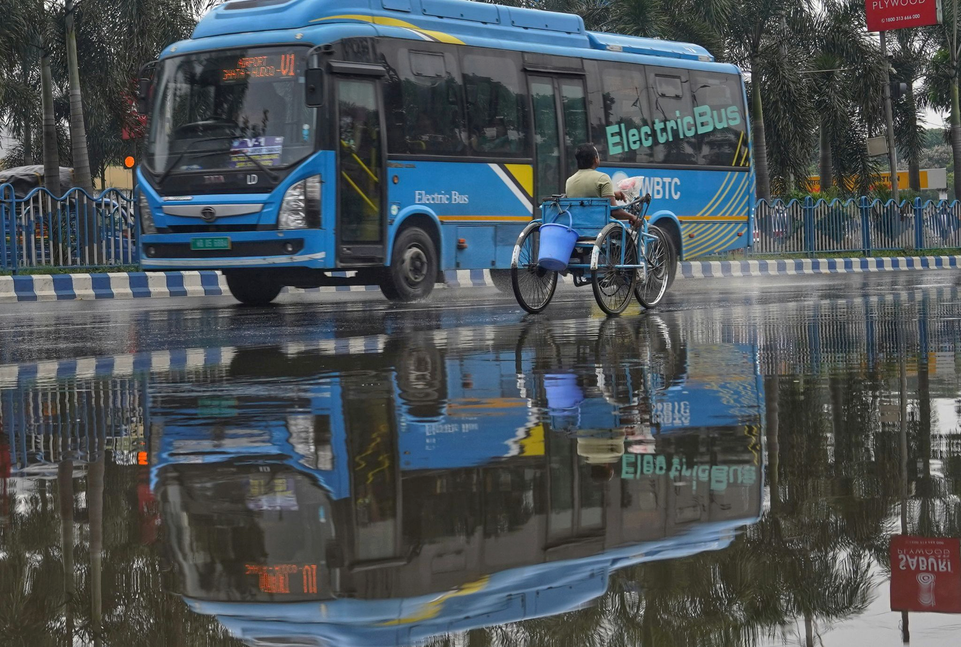
Road Network in Kolkata
Bus Services in Kolkata
Rail Transport in Kolkata
Tram in Kolkata
Metro Rail in Kolkata
Taxis in Kolkata
Rickshaws and Auto-Rickshaws in Kolkata

Slide 18

Kolkata's Recreation and Entertainment: A City Full of Life
Kolkata, the "City of Joy," offers a vibrant tapestry of experiences that cater to every taste when it comes to recreation and entertainment. From historical landmarks and cultural extravaganzas to adrenaline-pumping adventures and serene getaways, Kolkata keeps you coming back for more.

Slide 19
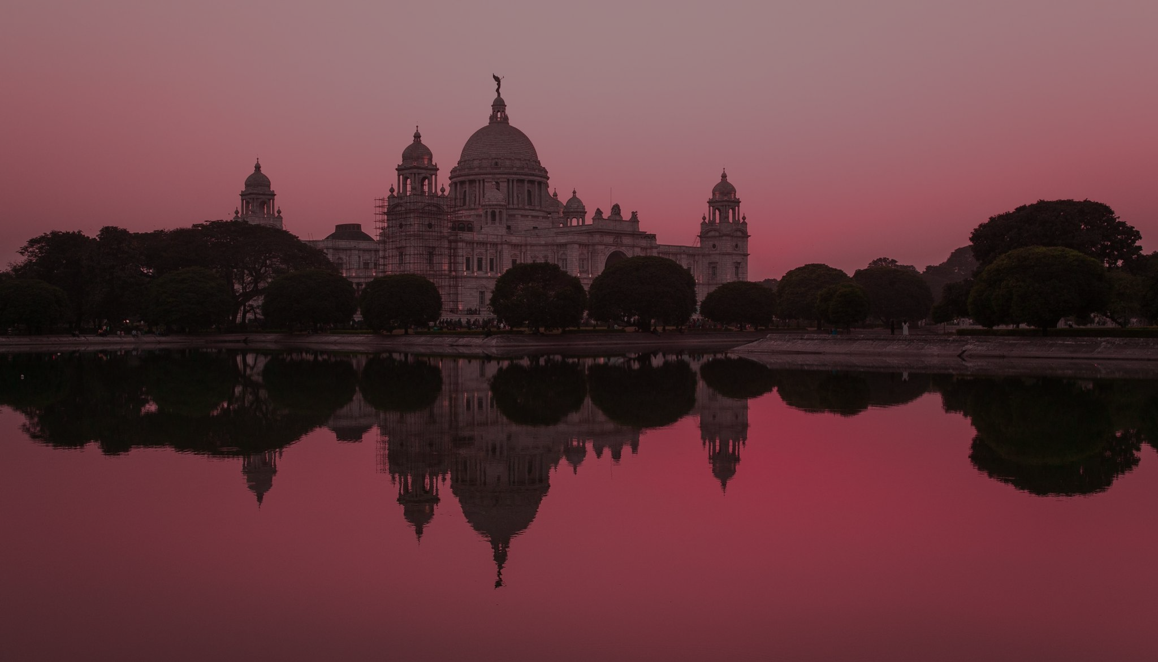
For the Culture Enthusiast:
KALI PUJA
SCIENCE CITY
NATIONAL MUSEUM
For the Thrill Seeker:
AQUATICA
ADVENTURE ZONE
NICCO PARK
For the history Buff:
Victoria Memorial
Fort William
St. Paul’s Cathedral
For the Serene Soul:
Rabindra Sarovar
Botanical Garden
Prinsep Ghat

Slide 20
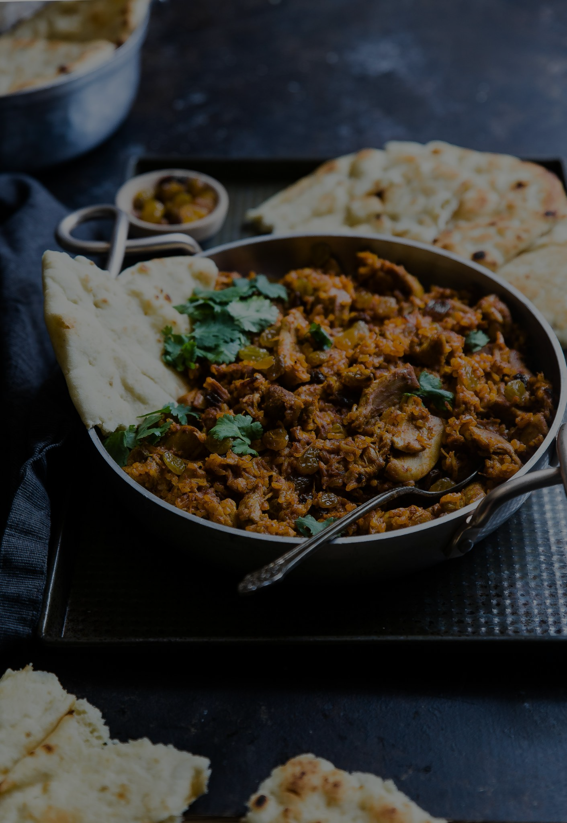
Kolkata street food – A melting pot of cultures
Kolkata, formerly known as Calcutta, has a rich and diverse food history as said before, that reflects its cultural heritage and the influence of various communities that have settled in the city over the years. The city’s cuisine is a blend of traditional Bengali flavours, colonial influences, and international culinary styles. The cuisine emphasizes the use of rice and fish, given the abundant water resources in the region. Dishes like macher jhol (fish curry), shorshe ilish (hilsa fish in mustard sauce), chingri malai curry (prawn in coconut milk), and sweets like Roshogolla and Sandesh are iconic examples of Bengali culinary heritage.

Slide 21
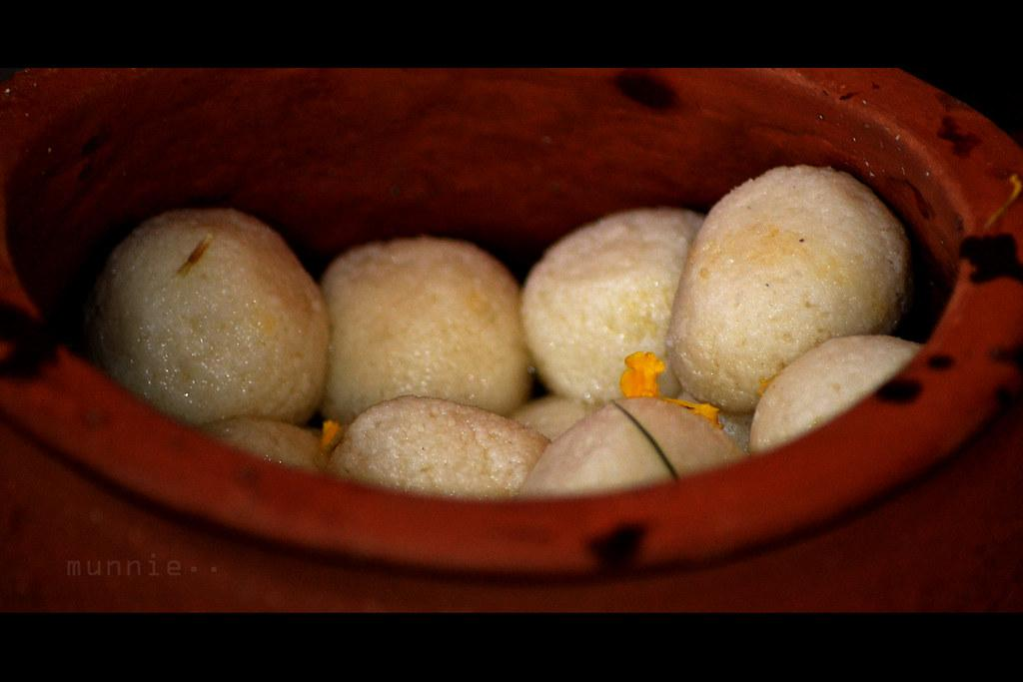
The Essence of Bengal’s Ethnic Sweetmeats
Bengal, like its delectable variants of food, also boasts of a rich sweet tradition. After all, it is the birthplace of the iconic Rosogolla. However, despite a wide variety of desserts, the sweet image of Bengal has somehow stayed stuck at the quintessential Rosogolla, Mishti Doi and Sandesh.

Slide 22
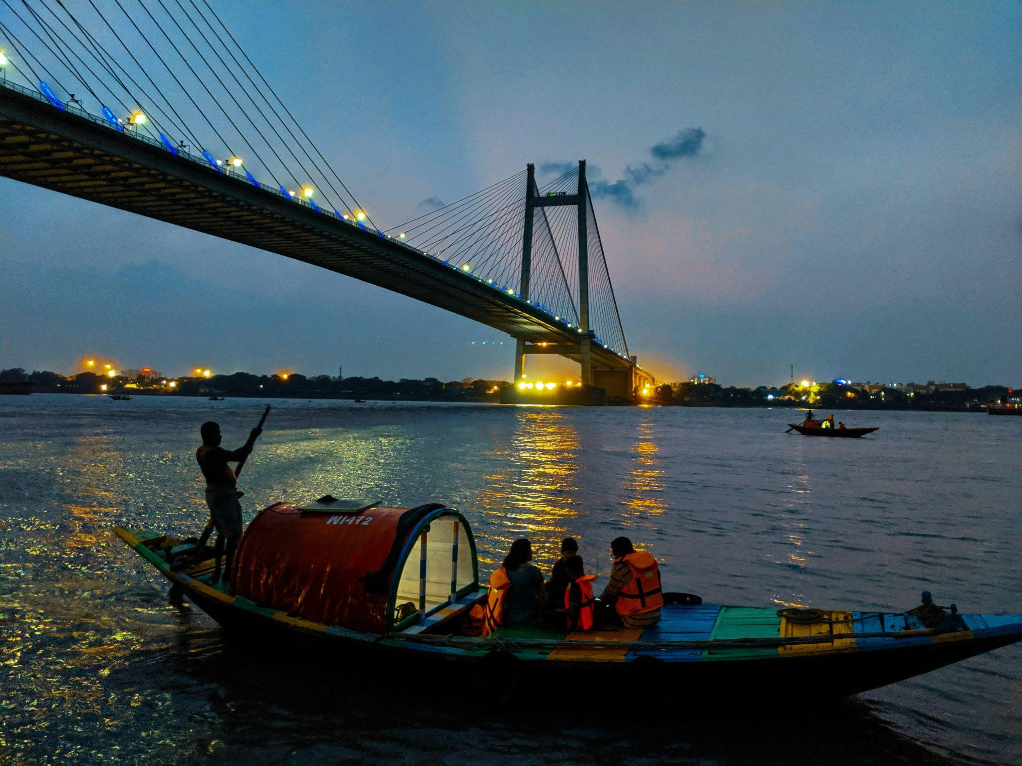
The city here is famous for being the oldest port in India. Kolkata has been called one of the major tourist destinations due to its diverse cultures. A singularly vital centre of history, art, and culture in India, Kolkata is a city everyone needs to experience at some point in their lives.

Slide 23
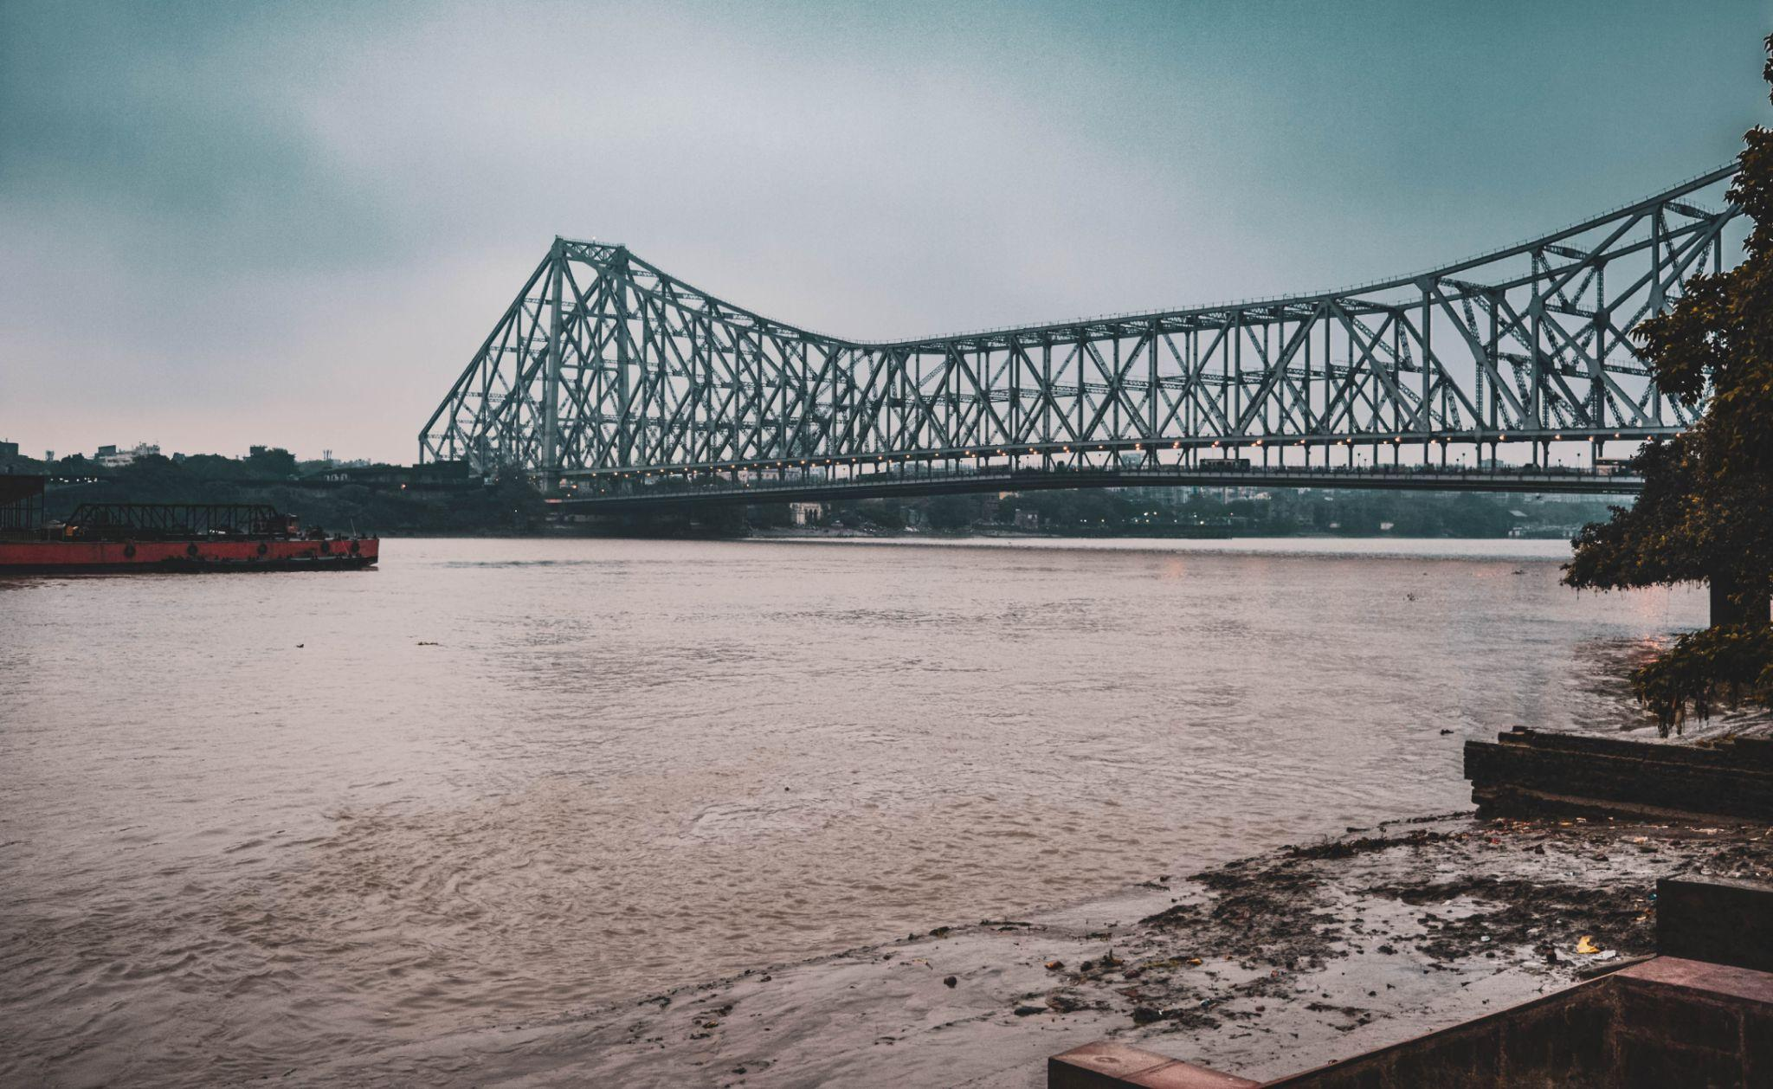
The 'City of Joy' earned its nickname because of its unfettered enthusiasm for its culture, tradition.
Kolkata has something for everyone. From art and literature, to sports, food, shopping, history, architecture,religion,spiritualism and even politics. There is more to Kolkata one can ever imagine and with that it was a wrap up for our beautiful city , the city of joy.

Slide 24


